Slide 1
Real Time Streaming and Analysis for Stock Data
Group-4 Divya Nalam Harika Boyina Fnu Maria Poulose Sai Charishma Kurmala Madhulika Dutta
Notes:
Entered text
big data streaming
Entered text
big data streaming

Slide 2

Introduction
Real-time stock data holds particular significance for algorithmic trading systems and day traders, facilitating swift decision-making aligned with market conditions.
Artificial intelligence and machine learning algorithms meticulously scrutinize extensive datasets, uncovering hidden patterns that illuminate market behavior and forecast future trends.
Our primary focus is on constructing a scalable and efficient data pipeline designed to seamlessly handle the ingestion, processing, analysis, and visualization of substantial volumes of real-time stock data.

Slide 3
Project Motivation
Need for Real-time Insights in Financial Market
Leveraging advancements in Big Data Technologies
Empowering Data-Driven Decision Making
Educational Value in Big Data Learning

Slide 4
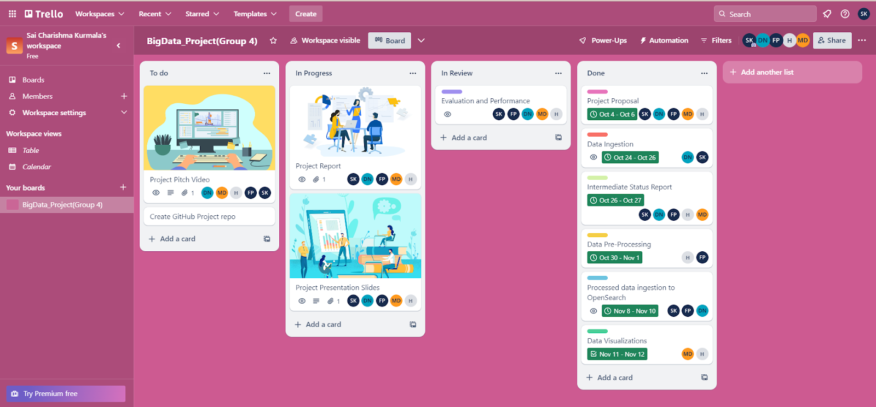
PROJECT MANAGEMENT
TRELLO BOARD TO PLAN THE PROJECT,SCHEDULE THE TASKS,ASSIGNEE MEMBERS FOR EACH TASKS AND KEEP TRACK OF THE PROGRESS
https://trello.com/b/KVn1d2UD/bigdataprojectgroup-4

Slide 5
Literature Survey
Title of the Paper | Goal of the paper | Method | Conclusion
Propositional Aspect between Apache Spark and Hadoop Map-Reduce for Stock Market Data | To analyze the influence of COVID-19 on stock markets using nifty-50 data and compare Apache Spark and Hadoop Map-Reduce for stock market data analysis. | Research utilizing Apache Spark technology on stock market data. | Apache Spark technique is superior for analyzing stock exchange data.
Stock Market Analysis from Twitter and News based on Streaming Big Data Infrastructure | To develop a real-time processing system for analyzing correlations between Twitter data and stock market movements. | Real-time data processing with Apache Spark, Apache Flink, and Apache Storm. | Achieved 80% accuracy in identifying stock value trends from Twitter data classification.

Slide 6
Title of the Paper | Goal of the Paper | Method | Conclusion
Stocks Analysis and Prediction Using Big Data Analytics | To predict daily gains in the US stock market using real-time Yahoo Finance data. | Analysis using Cloudera-Hadoop data pipeline and Spark machine learning module. | Effective prediction of high daily gains stocks using big data analytics.
Early Warning System in Volume Burst Risk Assessment of Stock with Big Data Platform | To assess volume burst risk in stock trading and provide risk notifications. | Analysis using the real-time stream data processing architecture in the big data Spark framework. | Developed criteria for volume risk rating in stock trading to aid investors in high-risk trading decisions.
Real-Time Processing of Big Data Streams: Lifecycle, Tools, Tasks, and Challenges | To define the lifecycle of big data processing in real-time and discuss the challenges and tools involved. | Examination of real-time big data processing solutions and challenges. | Provided comprehensive insights into the lifecycle, tools, and challenges of real-time big data processing.

Slide 7
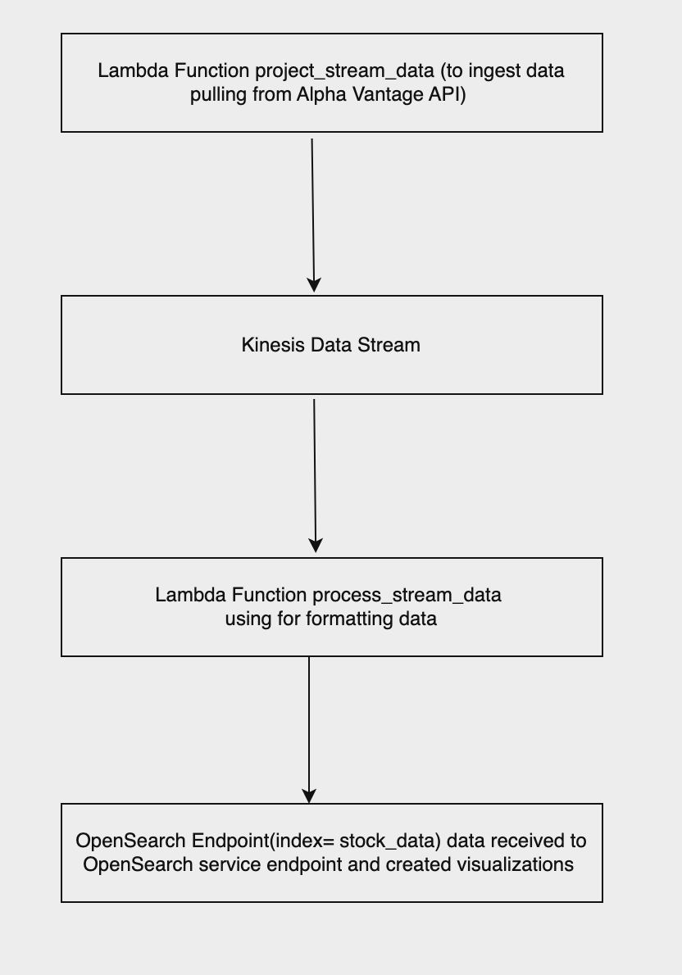

Project Workflow
Our project employs a robust, serverless architecture designed to process and analyze real-time stock market data
The architecture is composed of several AWS services that work in tandem to provide a seamless data flow from ingestion to visualization
The final component of our architecture involves creating visualizations from the indexed data in OpenSearch
Utilizing the service's built-in visualization tools, we construct interactive dashboards that present the real-time analysis of stock data

Slide 8
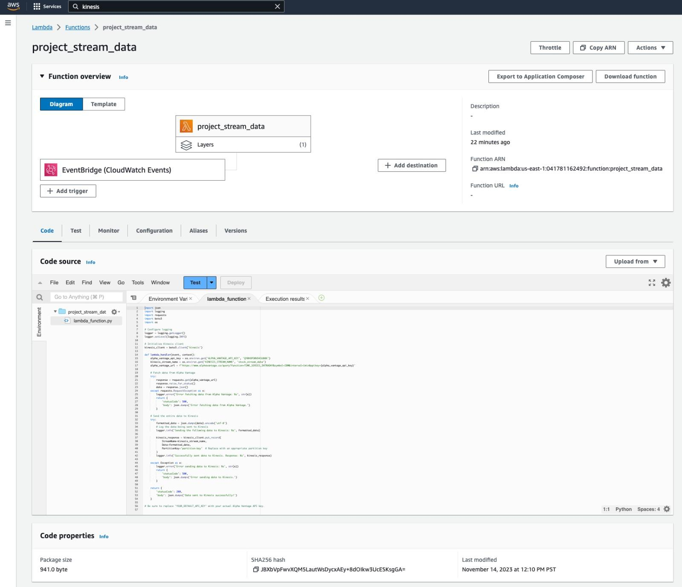
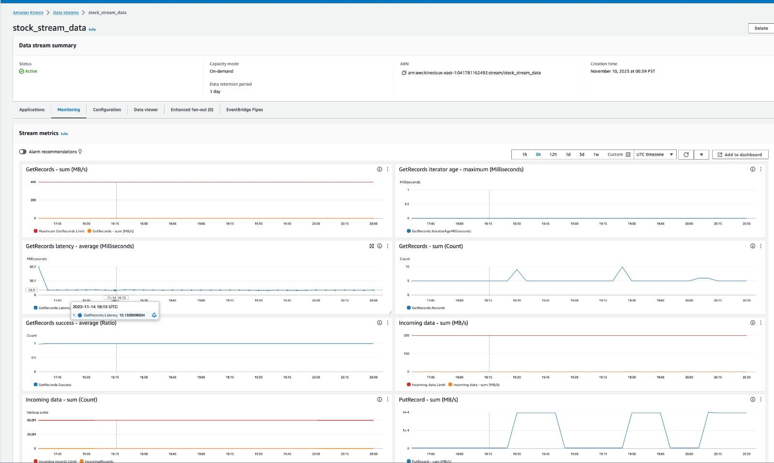
Methodology
An AWS Lambda function is created to ingest data from the Alpha Vantage API and process it on AWS.
A layer has been implemented to improve the maintainability and efficiency of the Lambda function that is in charge of ingesting data from Alpha Vantage.
This AWS Lambda function retrieves intraday IBM stock data from the Alpha Vantage API.
It then formats the data and broadcasts it into a Kinesis Data Stream without any interruption.
The function is set up to execute every minute and returns pertinent results.

Slide 9
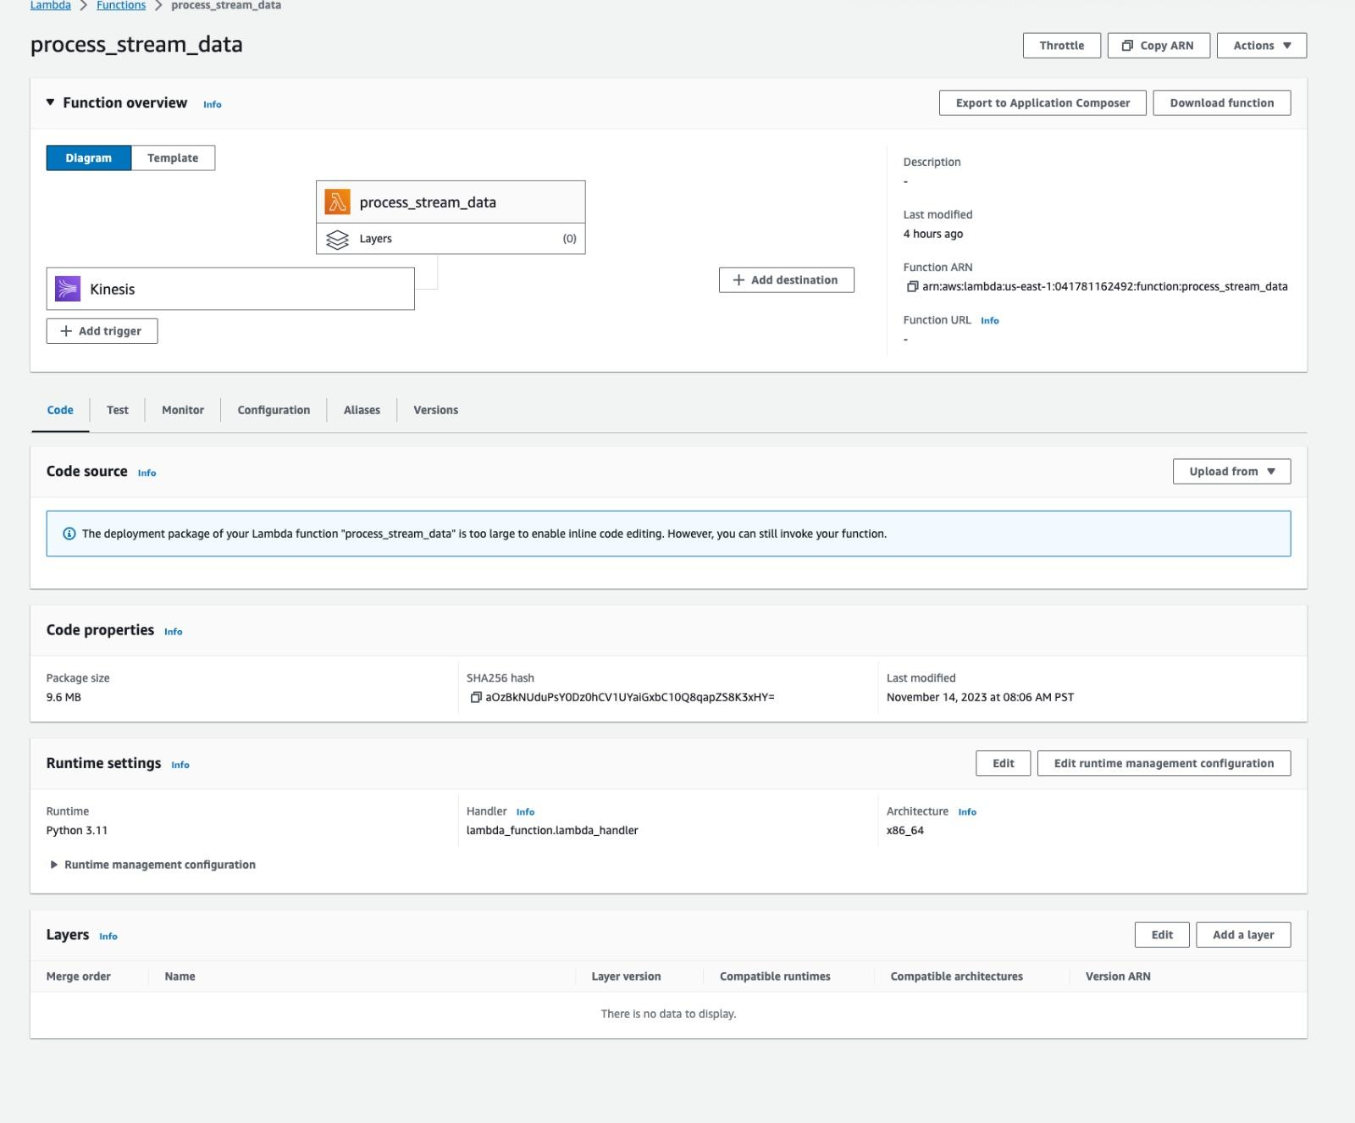
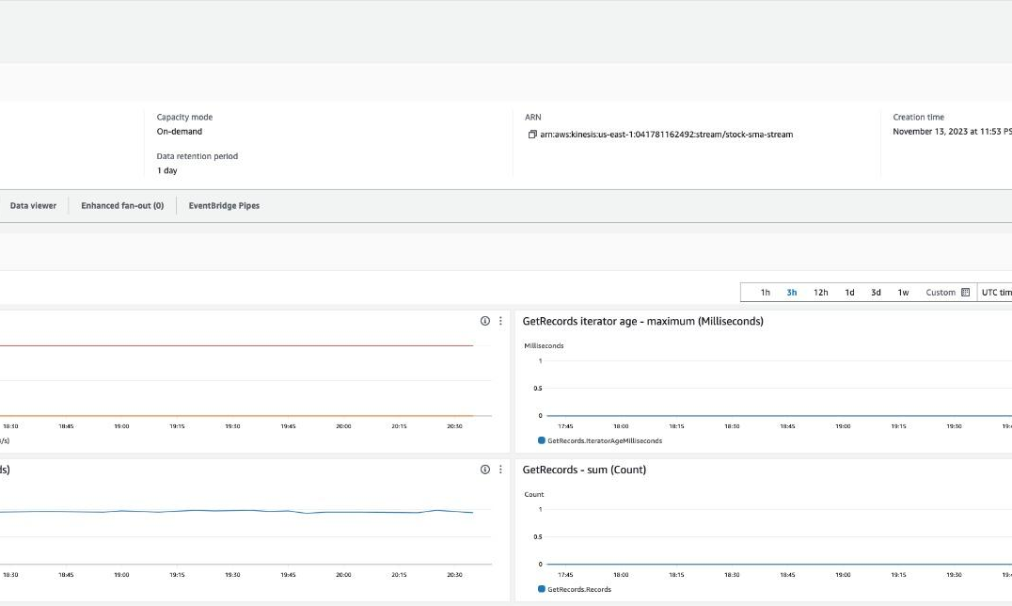
Methodology
Data is broadcast to the "stock_stream_data" Kinesis Data Stream after it has been processed by the Lambda function.
Comprehensive metrics such as "Get Records Success" "Get Records Iterator Age," "Incoming Data - Sum," "Put Record - Sum" are calculated
Concise summary of the Kinesis stream's performance is given by visualizations
A new Lambda function 'process_stream_data' was created to handle data extracted from a Kinesis Data Stream.
This function is crucial for cleaning up the data before it is transmitted to the OpenSearch endpoint.

Slide 10
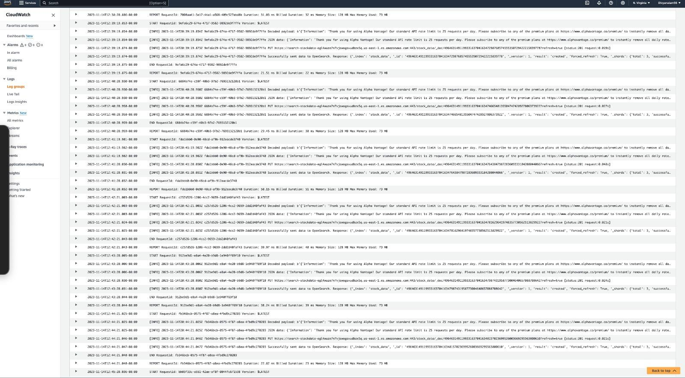
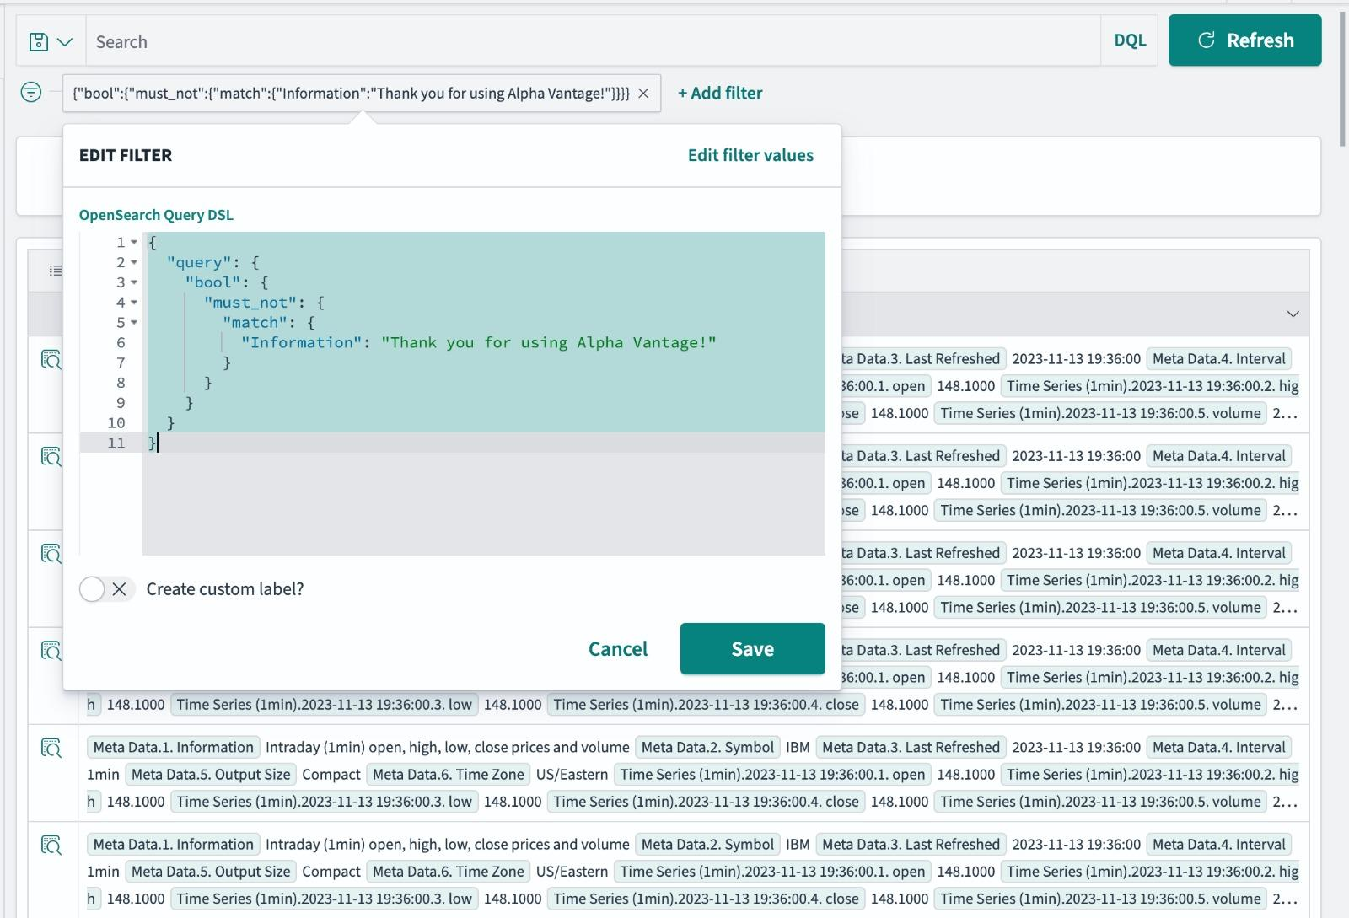
Methodology
A new Kinesis Data Stream "stock-sma-stream" was established to store processed data.
Processed data stream is transmitted from the Lambda function(process_stream_data) to the OpenSearch Service
This is confirmed by the CloudWatch logs obtained at the end
The data is successfully ingested and available for exploration within the OpenSearch environment
Warnings produced by the API are handled by implementing a filter in OpenSearch

Slide 11
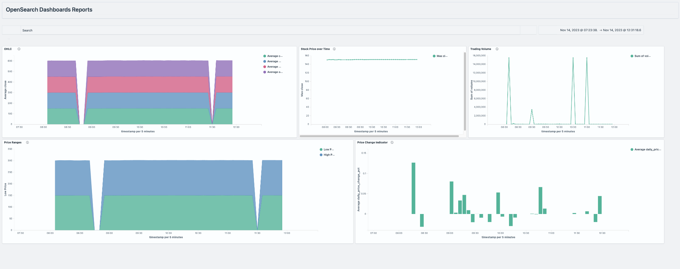
Visualizations

Slide 12
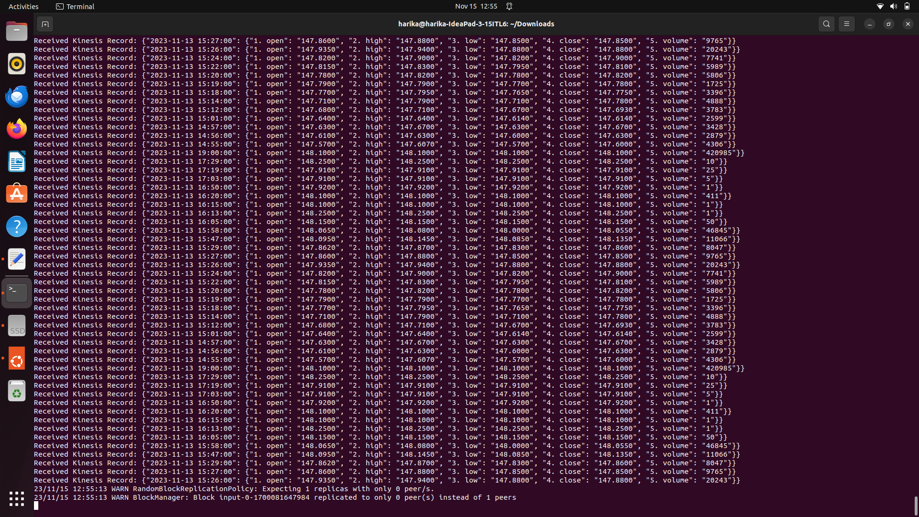
Another Approach using spark
Streaming data from AWS kinesis in spark.

Slide 13
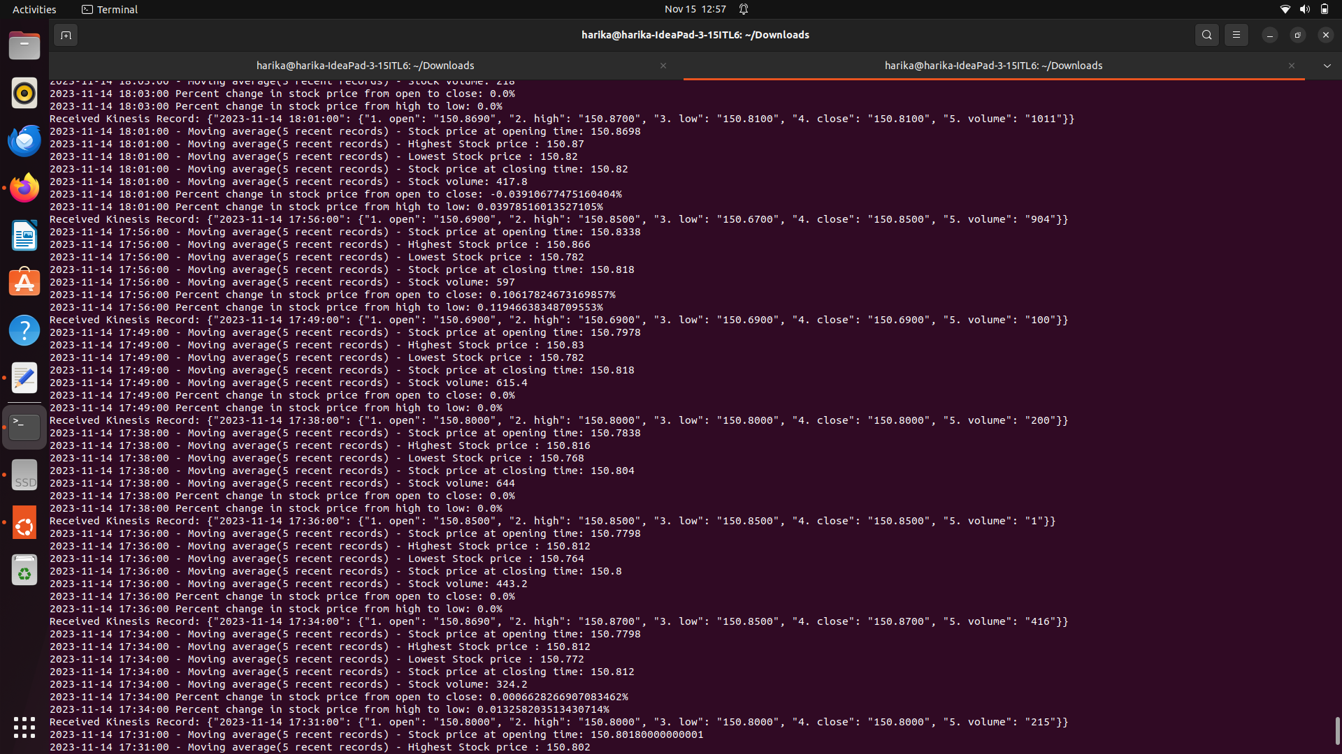
Aggregations in spark for kinesis data
Aggregations :
Showing the percentage change in stock price from open to close, high to low for real time streaming data.
Moving averages of all columns.

Slide 14
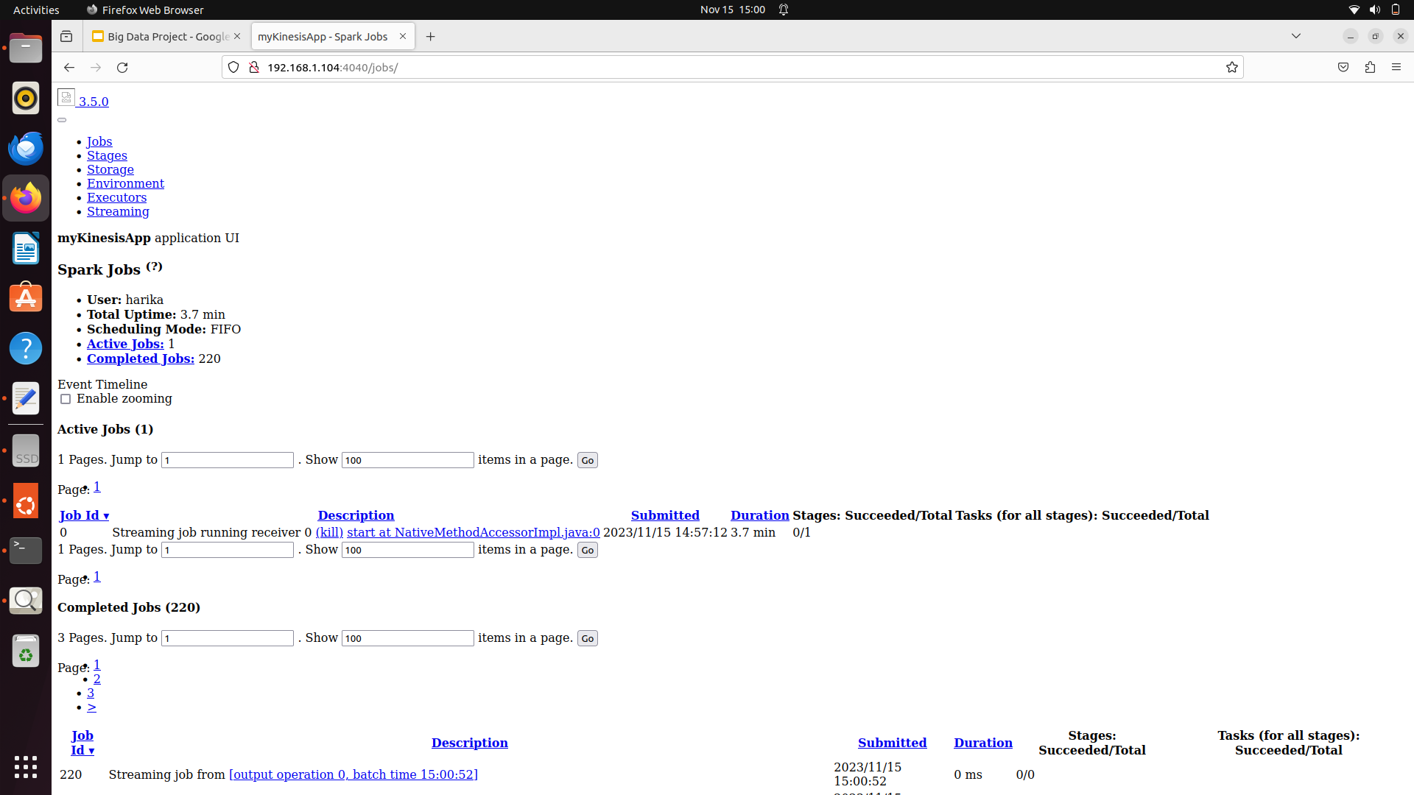
Spark home page
As it is real time streaming data, number of jobs getting increased accordingly.

Slide 15
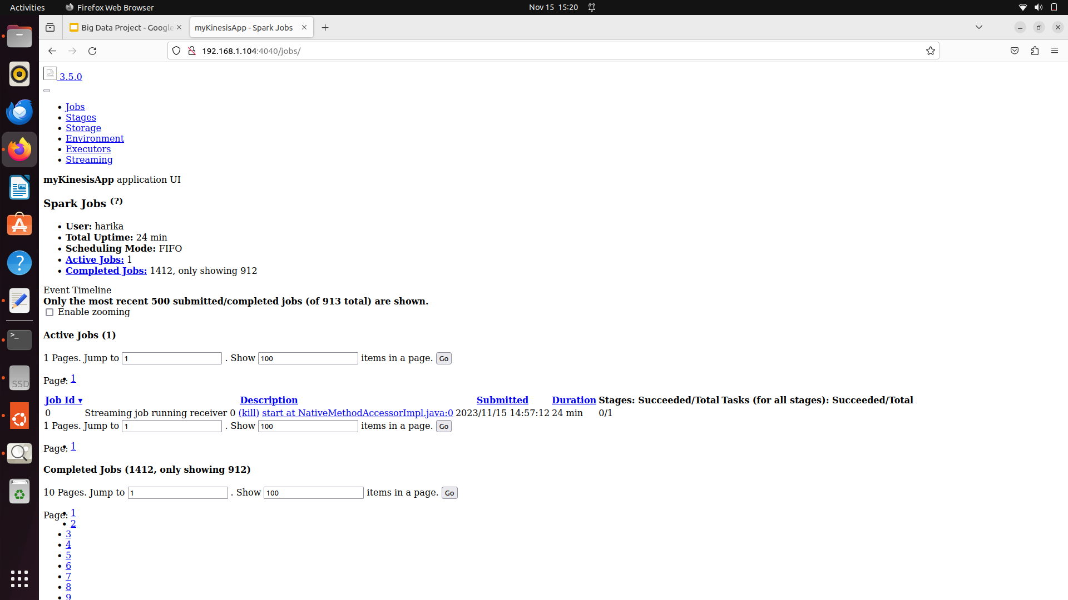
Spark Jobs
Spark jobs getting increased to handle the real time incoming aggregated data.
Hosted Spark using local machine ip address. So anyone can access within the network.

Slide 16
Key Lessons
Valuable learning opportunities beyond the technical aspects, such as project planning, workflow management, task coordination.
In-depth understanding of several cloud-based services like AWS, Lambda, OpenSearch, etc.
Contribution to financial data analysis by uncovering valuable insights that can be utilized for informed decision-making
Hands-on experience with Big Data applications to implement scalable and efficient solutions leveraging this technology
How to effectively capture, process, and analyze streaming data in real time, which is crucial in the field of big data.

Slide 17
Innovation Factors
Serverless Data Ingestion and Processing
Real-time Data Streaming with Kinesis
Interactive Data Visualization with OpenSearch Dashboards
Cloud-based Search and Analytics Engine
API Data Retrieval Optimization

Slide 18
Novelty Uniqueness
The innovative use of OpenSearch stands out as a significant contribution to the domain of real-time data streaming and analysis in the stock market.
Real-time Analysis and Visualization:
The project takes advantage of OpenSearch’s real-time analytics and visualization tools to provide a live dashboard of stock market dynamics.
This enables an unprecedented level of responsiveness for financial analysts and investors who rely on up-to-the-minute data to make informed decisions.
In summary, the novelty of our project lies not only in the technical implementation but also in its pioneering approach to financial data analysis.
We have ventured into a relatively unexplored area with OpenSearch, overcome its complexity to build functional and insightful visualizations for IBM data, and in doing so, have set a precedent for future explorations and innovations in this space

Slide 19
Technical Difficulty
API Request Limitation: The free API key from Alpha Vantage limited us to only 25 requests per day, posing a significant constraint for continuous data access. To overcome this, a premium subscription is necessary for more extensive and frequent data usage.
Complex Integration with AWS Lambda and OpenSearch Service
Pushing processed data from AWS Lambda to OpenSearch Service involved several complex steps:
OpenSearch Service Endpoint Setup: Configuring the OpenSearch service endpoint was crucial for a seamless connection between AWS Lambda and OpenSearch.
Index Pattern Creation: Creating an index pattern in OpenSearch was essential for efficient data organization and retrieval.
Data Formatting: Proper formatting of the Alpha Vantage API data was required to ensure compatibility with OpenSearch.
Data Fields and DataTypes Management: Correctly mapping data fields to their appropriate data types in OpenSearch was vital for accurate data representation and analysis.

Slide 20
Conclusion
The project, focusing on real-time data streaming and analysis of stock data using AWS services such as Kinesis, Lambda, and Elasticsearch, has successfully developed a dynamic, scalable system capable of managing high volumes of financial data.
This achievement is showcased through a real-time dashboard that visualizes and analyzes stock market trends and patterns. Key accomplishments include the system's adaptability to handle the rapid influx of stock data and its proficiency in providing immediate financial insights through interactive and informative dashboards created with Kibana.
Future enhancements could aim at optimizing costs, ensuring long-term data storage, bolstering security measures, and incorporating advanced analytics and machine learning for more nuanced financial analysis.
This implementation not only demonstrates the power and versatility of cloud-based solutions in financial data handling but also lays a groundwork for future advancements in the field of real-time stock market data analysis and visualization.

Slide 21
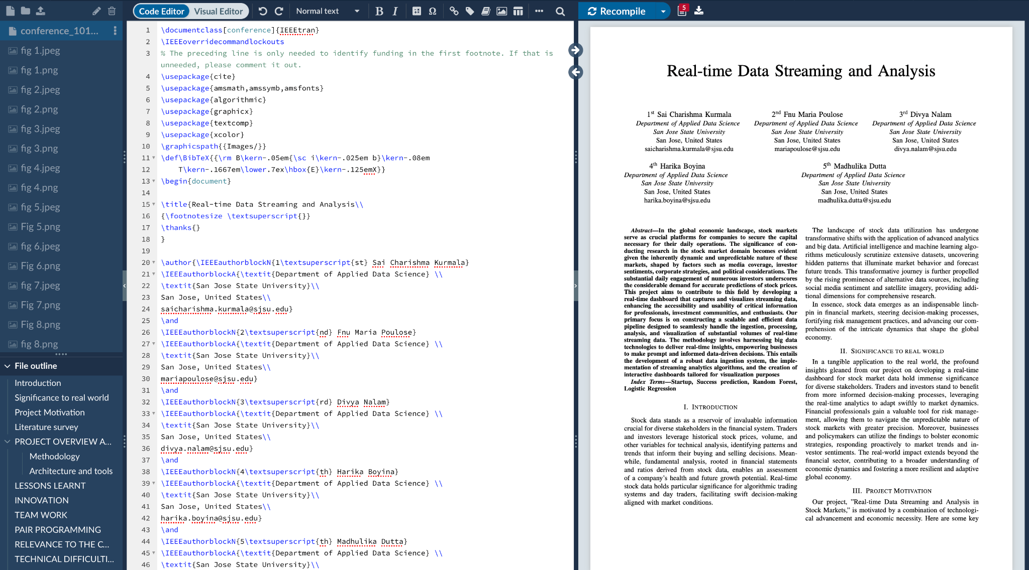
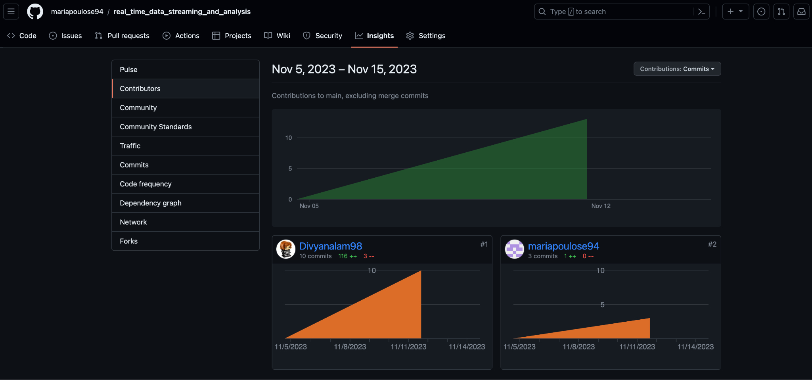
Links
Overleaf latex link- https://www.overleaf.com/project/6383c8973375423fe55271e3
Github Repository link - Pair Programming https://github.com/mariapoulose94/realtimedatastreamingandanalysis

Slide 22
References
[1]Y. K. Gupta and N. Sharma, "Propositional Aspect between Apache Spark and Hadoop Map-Reduce for Stock Market Data," 2020 3rd International Conference on Intelligent Sustainable Systems (ICISS), Thoothukudi, India, 2020, pp.479-483,doi:10.1109/ICISS49785.2020.9315977.
[2] C. Lee and I. Paik, "Stock market analysis from Twitter and news based on streaming big data infrastructure," 2017 IEEE 8th International Conference on Awareness Science and Technology (iCAST), Taichung, Taiwan, 2017, pp. 312-317,doi:10.1109/ICAwST.2017.8256469.
[3] Z. Peng, "Stocks Analysis and Prediction Using Big Data Analytics," 2019 International Conference on Intelligent Transportation, Big Data & Smart City (ICITBS), Changsha, China, 2019, pp. 309-312, doi: 10.1109/ICITBS.2019.00081.
[4] D. -H. Shih, H. -L. Hsu and P. -Y. Shih, "A Study of Early Warning System in Volume Burst Risk Assessment of Stock with Big Data Platform," 2019 IEEE 4th International Conference on Cloud Computing and Big Data Analysis (ICCCBDA), Chengdu, China, 2019, pp. 244-248,doi:10.1109/ICCCBDA.2019.8725738.
[5] F. Gürcan and M. Berigel, "Real-Time Processing of Big Data Streams: Lifecycle, Tools, Tasks, and Challenges," 2018 2nd International Symposium on Multidisciplinary Studies and Innovative Technologies (ISMSIT), Ankara, Turkey, 2018,pp.1-6,doi:10.1109/ISMSIT.2018.8567061.

Slide 23
Thank you Q & A Time

